Slide 2
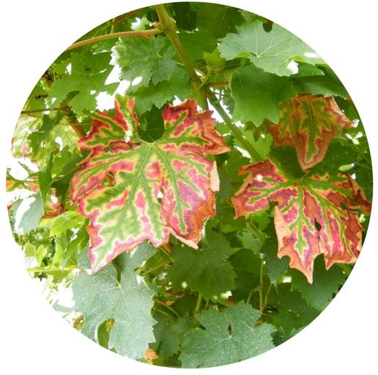
Grapevine Trunk Diseases
What are they?
GTDs are a group of fungal diseases that affects the perennial organs of the plant, leading to leaf and berries symptoms and sometimes also to the death of the plant

Slide 3
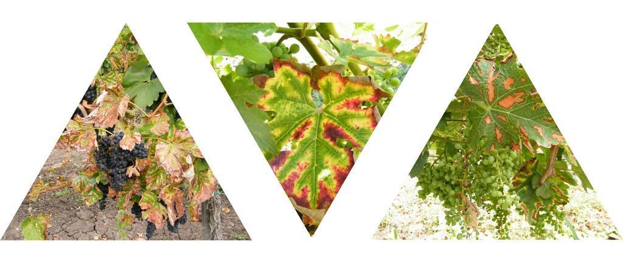
Grapevine Trunk Diseases
Why should we care?
GTDs cause huge economic losses (1,5 billion $ per year due to re-plantation worldwide), leading to production decrease (1 billion€ in France per year) in both quality and quantity
Notes:
Cost extimated in order to re-plant the vines that get infected every year.
While the economic loss of a billion Euros in France is due to the production decrease in both quality and quantity. The same goes for California (0,25 billion Dollars) and For Australia (8,3 billion dollars).

Slide 4
Grapevine Trunk Diseases
Why should we care?
Vineyard:
Loss of production, plant death and increased re-implantation costs
Winemaking:
Quali-quantitative damages in wine production (< sugar , >pH etc)
Notes:
In Addition to a smaller production also the quality of the grapes is reduced. Very important is the fact that the pH is higher. It is advisable not to use the grapes that come from an infected plant

Slide 5
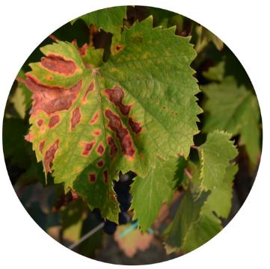
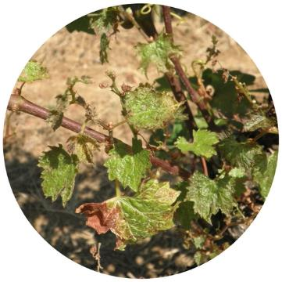
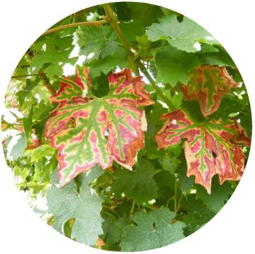
Grapevine Trunk Diseases
Who are they? (adult vineyard)
Botryosphaeria
Eutypa
Esca Compex
Chlorosis/necrosis on the leaves
Stunted development
Strong Chlorosis on the leaves
Striped leaves
Black spots on the berries

Slide 6
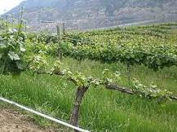
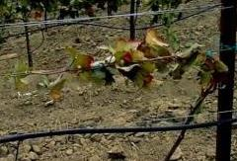
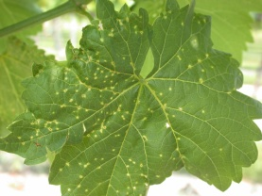
Grapevine Trunk Diseases
Who are they? (young vineyard)
Petri disease
Black Foot Disease
Phomopsis
Notes:
Maybe it could be skipped, is better to focus on the other 3

Slide 7
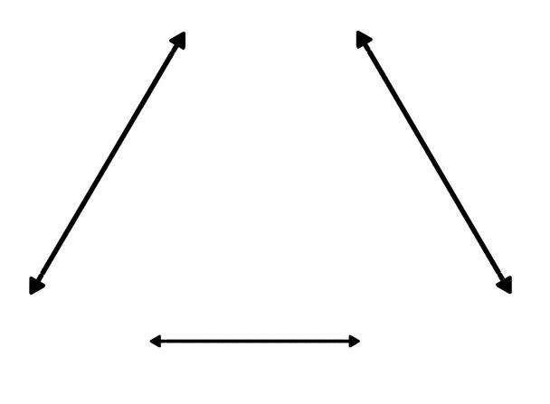
Grapevine Trunk Diseases
Why can’t we solve the problem?
Regular disease
(Downy Mildew)
Plant
Pathogen #1
Environment
Notes:
Managing regular diseases (like downy or powdery Mildew) is easier because the interaction between plant, pathogen and the environment is predictabe

Slide 8
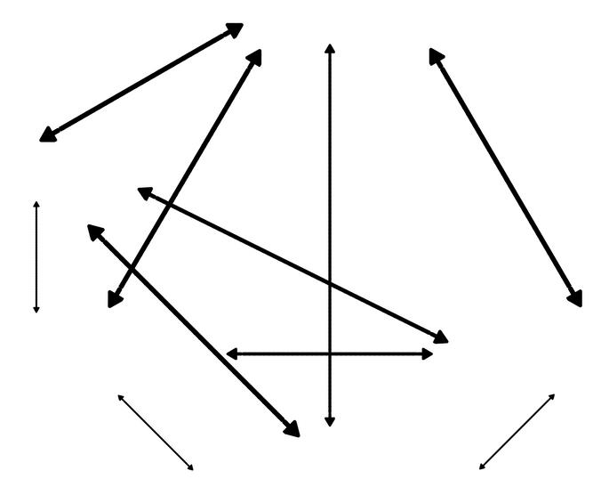
Grapevine Trunk Diseases
Why can’t we solve the problem?
GTDs
(Esca complex)
Plant
Pathogen #3
Pathogen #2
Environment
Pathogen #1
Notes:
While when you have 2 or more pathogens that cause a disease is difficult to predict the interaction of each pathogen

Slide 9
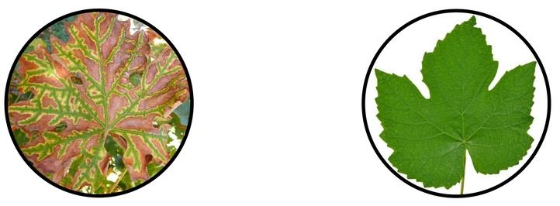
Grapevine Trunk Diseases
Why can’t we solve the problem?
The symptoms do not appear every year on the same plant
Notes:
An experiment made by Vincenzo Mondello showed that in two years only the 12% of the infected plant in a vineyard showed symptoms in both years.

Slide 10
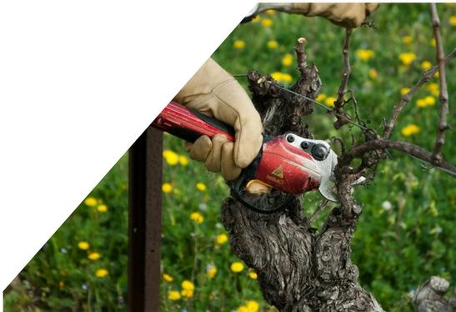
Grapevine Trunk Diseases
Why can’t we solve the problem?
GTDs pathogens diffusion is closely related to the vineyard management, especially pruning

Slide 11
Grapevine Trunk Diseases
Why can’t we solve the problem?
At the moment there is
NO
Effective control strategy
Notes:
No efficient strategies to control them after sodium arsenite use prohibition

Slide 12
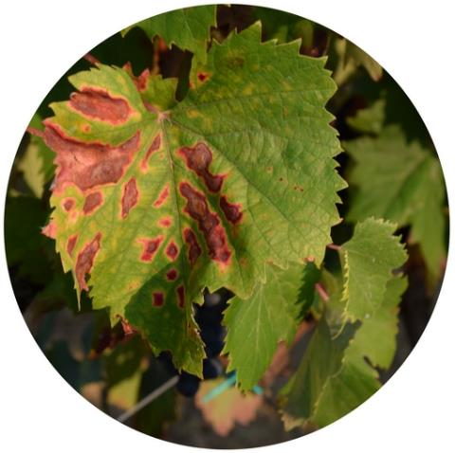
Grapevine Trunk Diseases
Pathogens lifecycle
The life cycle and epidemiology are very similar for all the fungi that cause trunk diseases (Berstch et al., 2013).
These diseases are cryptic and their symptoms usually take several years to
develop. As such they are difficult to observe.

Slide 13
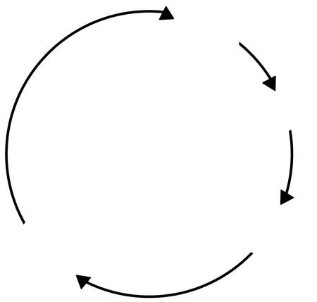
Grapevine Trunk Diseases
Pathogens lifecycle
Winter
Inoculum ready
Pruning wounds
Spread by rain
Autumn
Spring
Infection
Reproduction
Summer

Slide 14
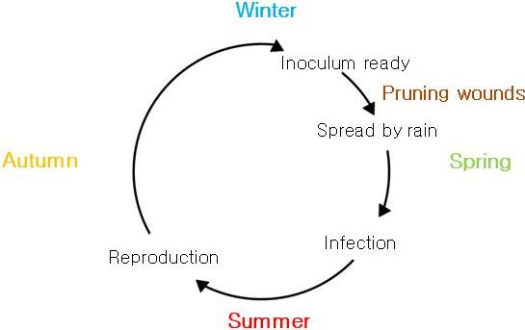
Grapevine Trunk Diseases
Pathogens lifecycle
Knowing the pathogens lifecycle is possible to decrease the infections by:
Reducing the inoculum
Pruning at the right moment

Slide 15
Grapevine Trunk Diseases
Reducing the inoculum
In order to reduce the inoculum is important to:
Remove the shoots as soon as they show symptoms
Remove a plant if it is infected
Remove the pruning residuals

Slide 16
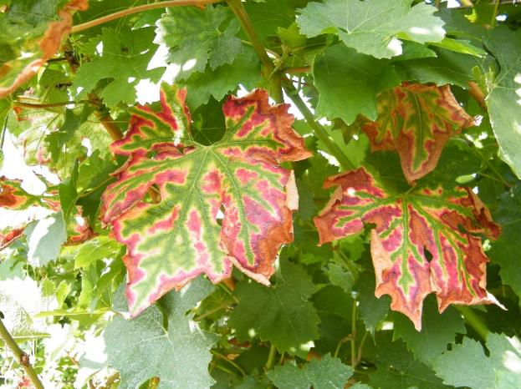
Grapevine Trunk Diseases
Remove a symptomatic shoot
If only a shoot shows symptoms, it is possible that only that shoot is infected.
Cut that shoot and see if the infection is spread in the rest of the plant.
If it is possible to see the fungi at the base of the shoot probably the plant is infected.

Slide 17
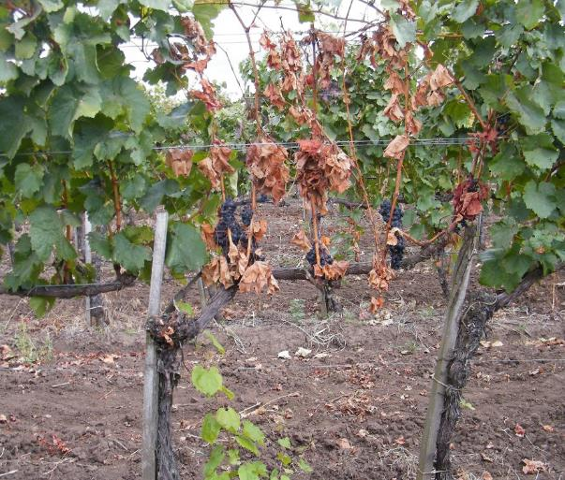
Grapevine Trunk Diseases
Remove a symptomatic plant
If a plant shows symptoms on all its canopy it means that is entirely infected.
At this stage the best thing would be to completely remove the plant.
Once a plant is cut or uprooted it should be removed (it could also be composted or burned) as soon as possible.

Slide 18
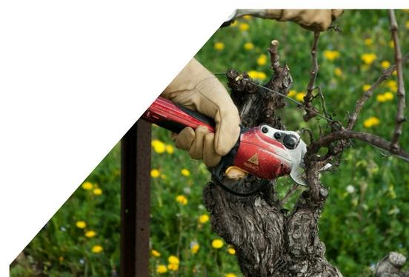
Grapevine Trunk Diseases
Pruning at the right moment
Pathogens infect the plant mostly through pruning wounds
Since the pathogens spores are spread by rain, is important to prune in the dry season.
In addition is possible to protect the pruning wounds with mastic or using Trichoderma

Slide 19
Grapevine Trunk Diseases
Quiz
Please answer to the given questions
Notes:
(15 minutes)

Slide 20
Grapevine Trunk Diseases
Video-clip Symptoms and Epidemiology

Slide 21
Grapevine Trunk Diseases
Quiz
Results and Discussion

Slide 22
Grapevine Trunk Diseases
Symptoms
The symptoms of Esca, Eutypa and Botryosphaeria are shown in the following pages.
Remember: the external symptoms are not enough to diagnose the disease. In order to be certain is necessary to look at the internal symptoms

Slide 23
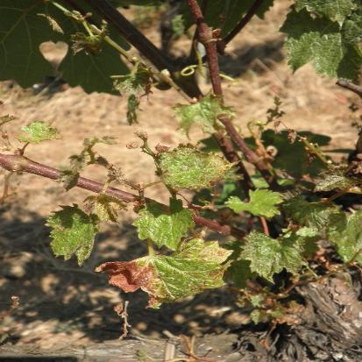
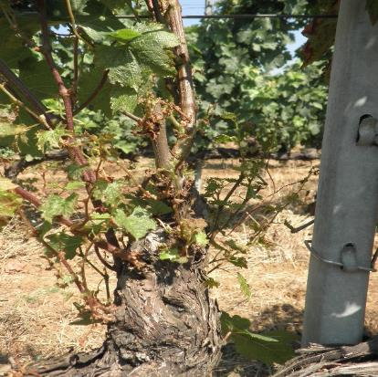
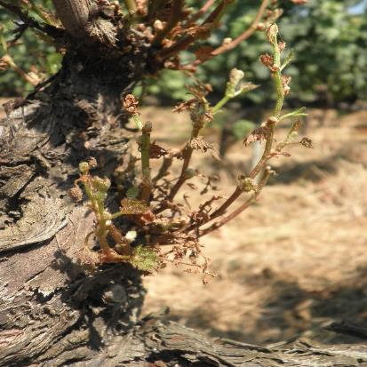
Grapevine Trunk Diseases
Eutypa Dieback
Eutypa Dieback most frequently shows symptoms in old vineyard (more than 10 years).
Moderately infected vineyards lose 30% of production, severely infected vineyards lose up to 80% of production

Slide 24
Grapevine Trunk Diseases
Eutypa Dieback
Eutypa Dieback external symptoms are very typical.
They can be seen as early as spring and they consist in:
Stunted development
Leaf chlorosis
Cup shaped leaves

Slide 25
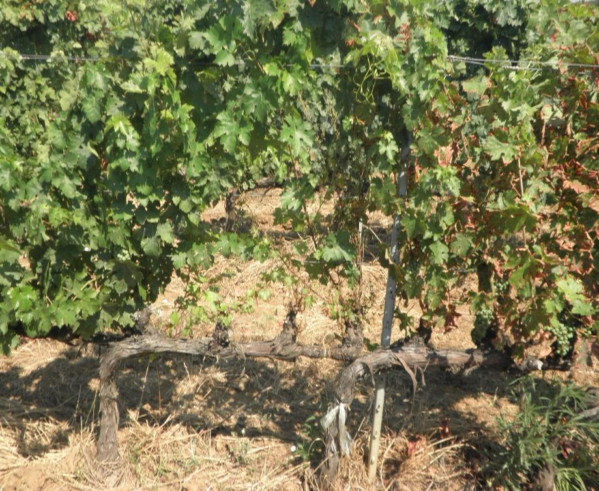
Grapevine Trunk Diseases
Eutypa dieback symptoms
Stunted development
Short internodes

Slide 26
Grapevine Trunk Diseases
Eutypa dieback symptoms

Slide 27
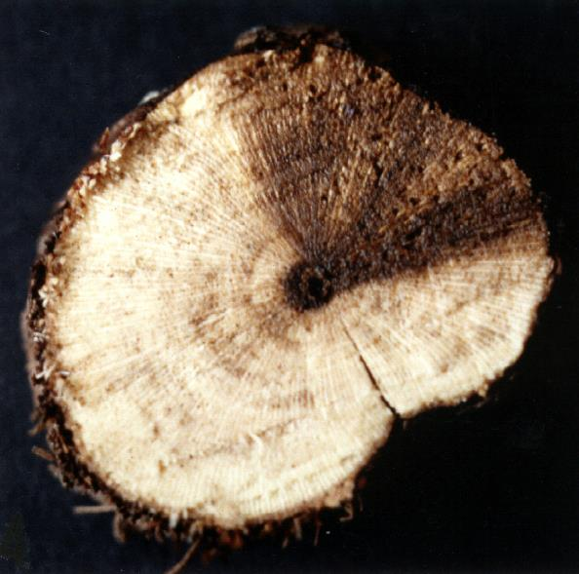
Grapevine Trunk Diseases
Eutypa dieback internal symptoms
When the symptoms on the exterior are seen, in order to verify the disease is possible to cut the trunk or the spur.
In the interior, if the plant is infected, you will see a dark portion of the wood with a wedge shape.

Slide 28
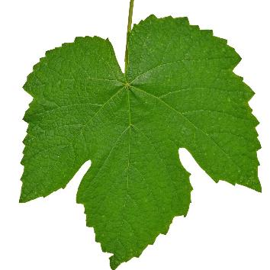
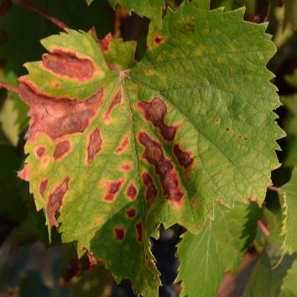
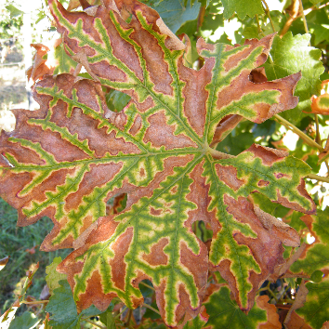
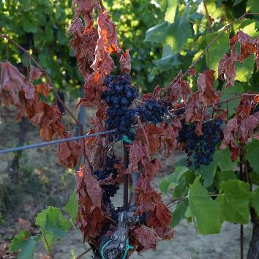
Grapevine Trunk Diseases
Esca Complex and Botryosphaeria have similar symptoms
No symptoms
Chlorosis/necrosis
Tiger striped leaves
Apoplexy

Slide 29
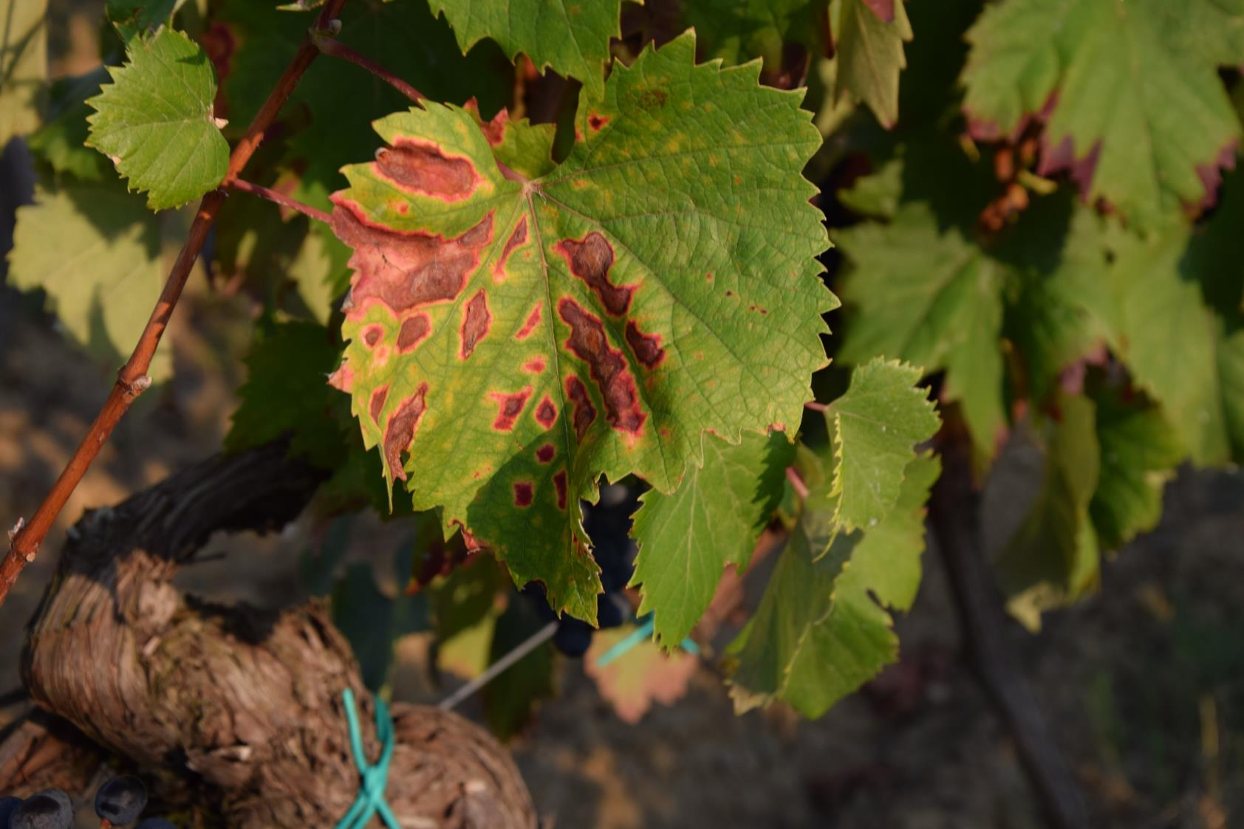
Chlorosis/Necrosis

Slide 30
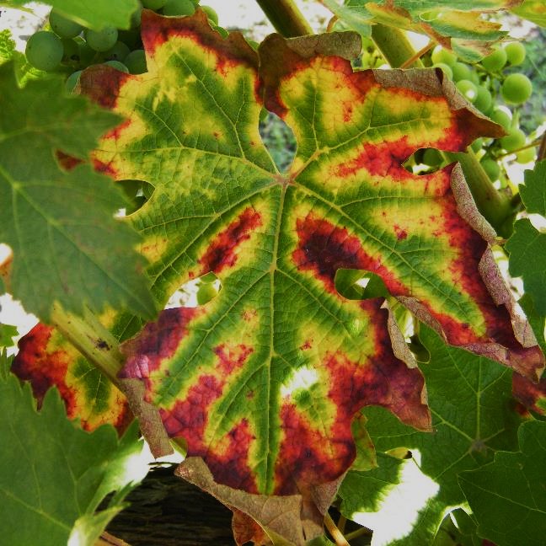
Tiger-striped leaves

Slide 31
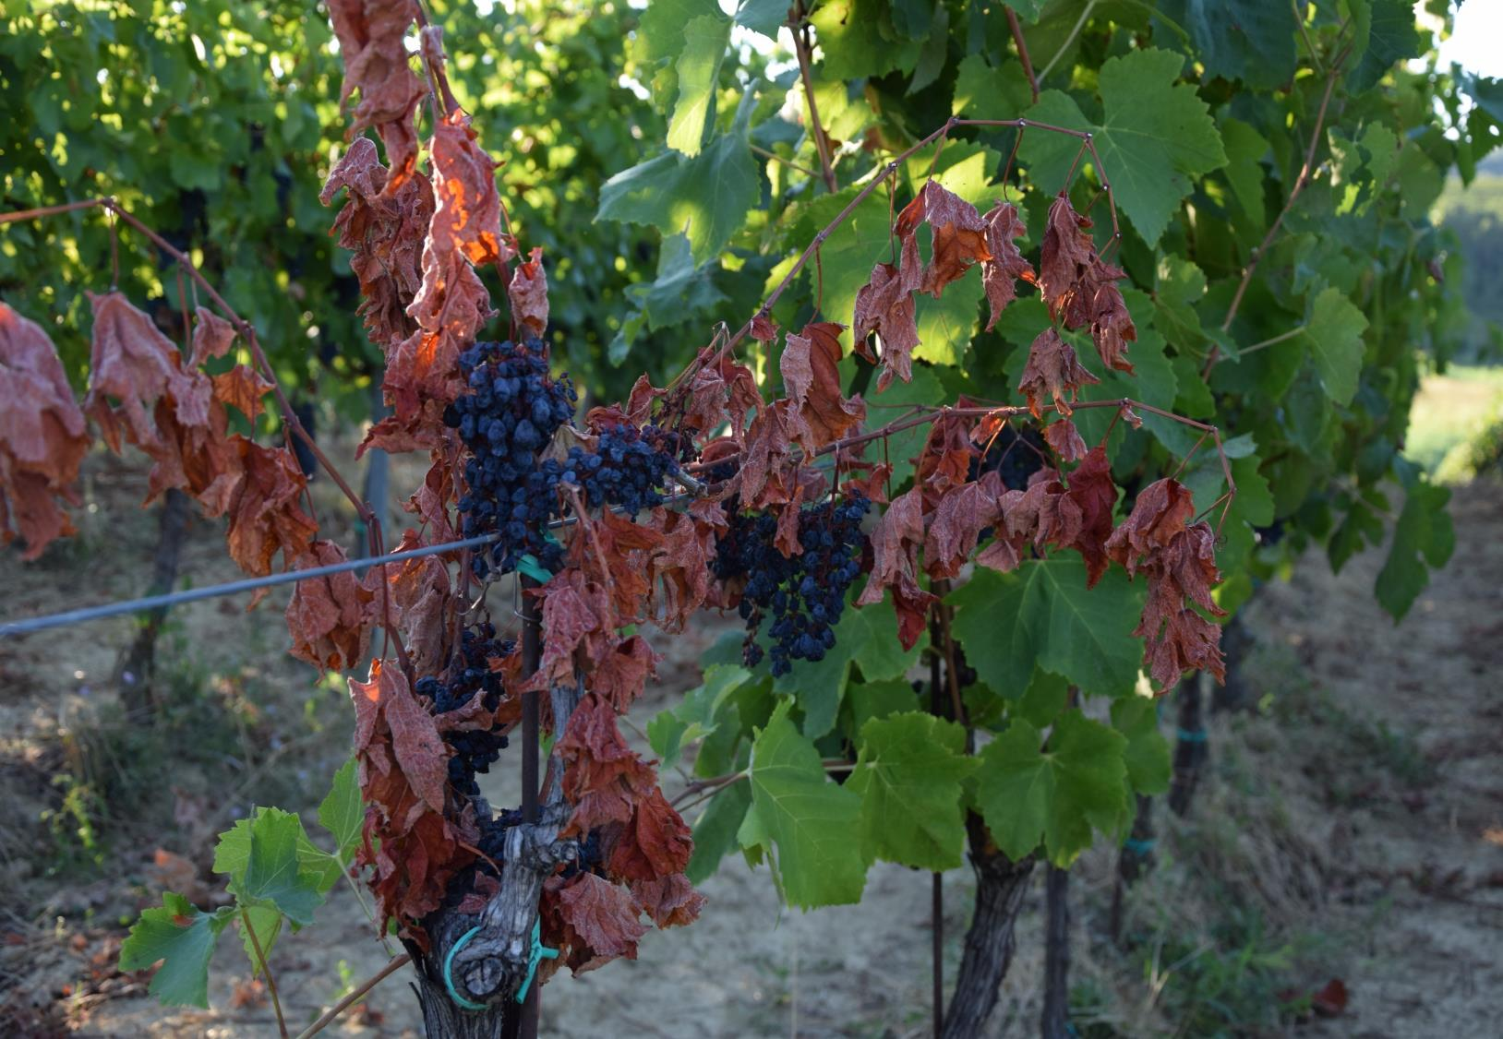
Apoplexy

Slide 32
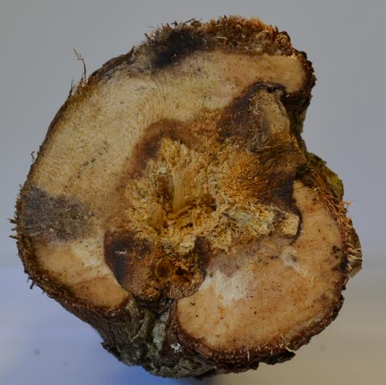
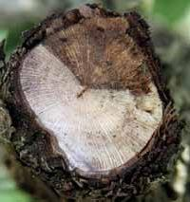
Grapevine Trunk Diseases
Esca Complex and Botryosphaeria have similar symptoms
The only way is possible to distinguish the two is to analyze the internal symptoms
Botryosphaeria
Esca Complex

Slide 33
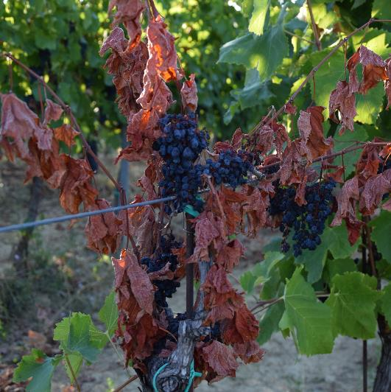
Grapevine Trunk Diseases
Esca Complex
Esca Proper can manifest itself in two different forms:
A fast appearance of the symptoms called apoplexy
A slow appearance of the symptoms with chlorosis/necrosis and tiger striped leaves

Slide 34
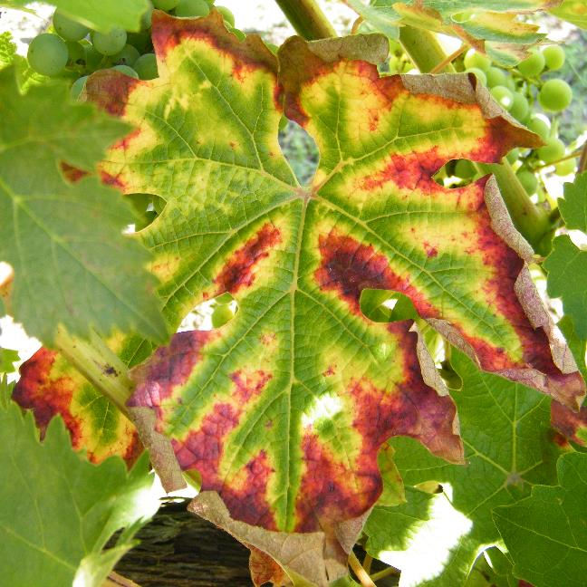
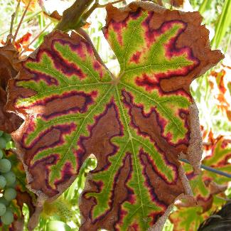
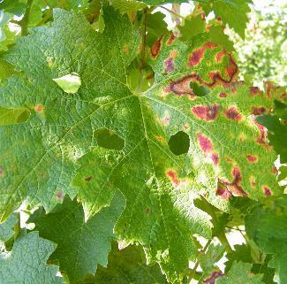
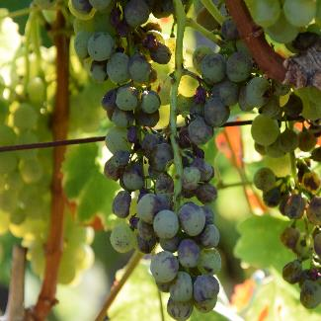
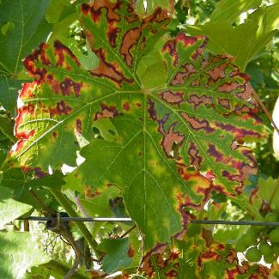
Grapevine Trunk Diseases
Esca Complex
The necrosis on the leaves result in grapes with less sugar and higher pH

Slide 35
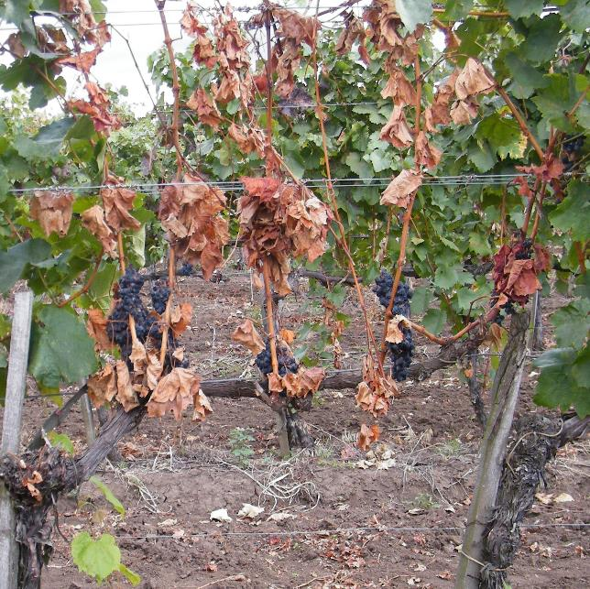
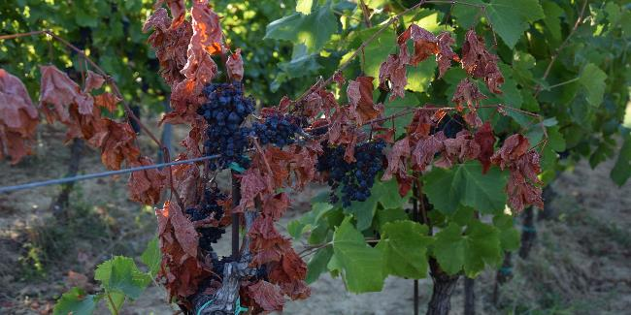
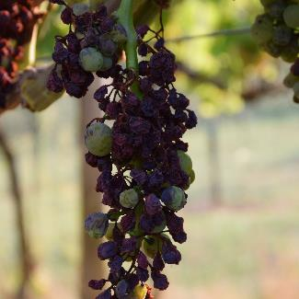
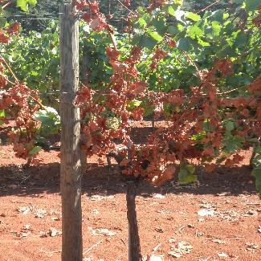
Grapevine Trunk Diseases
Esca Complex
Esca can also have a fast appearance, this is called apoplectic form.
The apoplectic form usually appears in the hottest period.

Slide 36
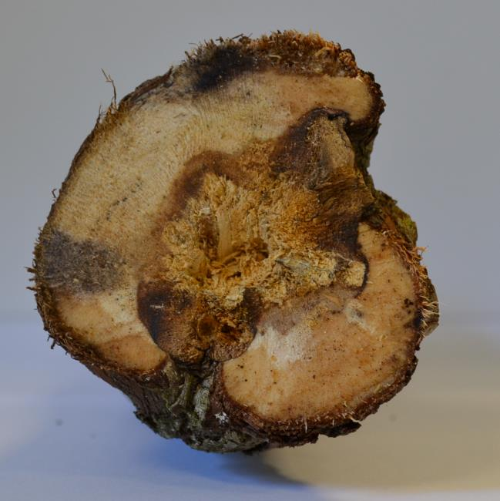
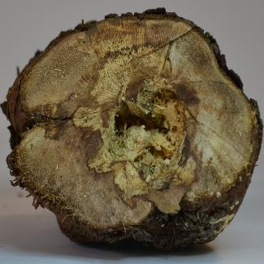
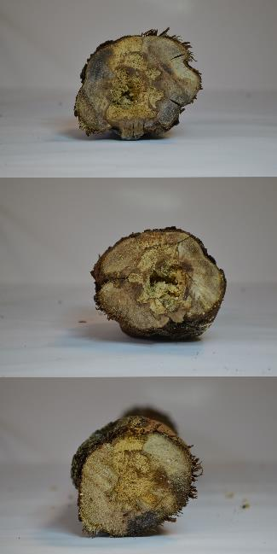
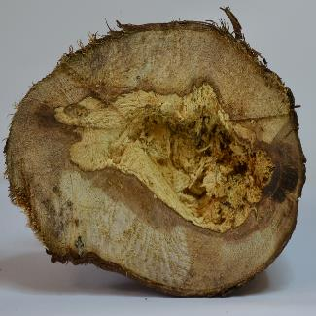
Grapevine Trunk Diseases
Esca Complex internal symptoms
In the inside of an infected trunk is possible to see two different parts, a black and a with one; they are caused by two different fungi.

Slide 37
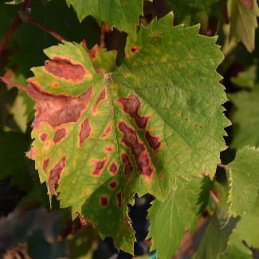
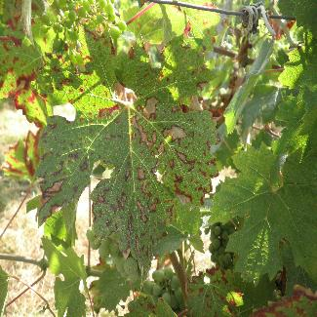
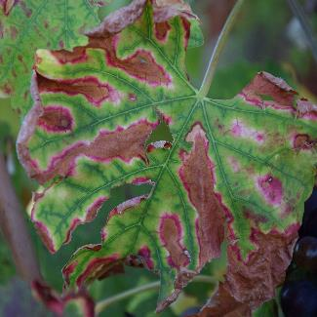
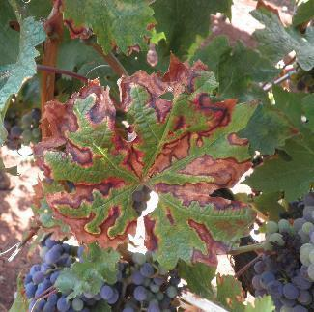
Grapevine Trunk Diseases
Botryosphaeria dieback
Botryosphaeria shows exterior symptoms similar to esca, only cutting the trunk is possible to diagnose the disease

Slide 38
Grapevine Trunk Diseases
Thanks for the attention

Slide 39
Grapevine Trunk Diseases
1
Symptom’s quiz
Notes:
Esca

Slide 40
Grapevine Trunk Diseases
2
Symptom’s quiz
Notes:
eutypa

Slide 41
Grapevine Trunk Diseases
3
Symptom’s quiz
Notes:
Empoasca vitis bites

Slide 42
Grapevine Trunk Diseases
4
Symptom’s quiz
Notes:
Esca-bot

Slide 43
Grapevine Trunk Diseases
5
Symptom’s quiz
Notes:
Fe Deficit

Slide 44
Grapevine Trunk Diseases
6
Symptom’s quiz

Slide 45
Grapevine Trunk Diseases
7
Symptom’s quiz
Notes:
FD

Slide 46
Grapevine Trunk Diseases
8
Symptom’s quiz
Notes:
euty

Slide 47
Grapevine Trunk Diseases
9
Symptom’s quiz
Notes:
Esca

Slide 48
Grapevine Trunk Diseases
10
Symptom’s quiz
Notes:
botry

